Slide 1
2160704
Theory of Computation
Turing Machine

Slide 2
Topics to be covered
What is Turing Machine?
Formal Definition: Turing Machine
Design of Turing Machine
Universal Turing Machine
Church Turing Thesis

Slide 3
Introduction
Finite Automata
Input Strings
Pushdown Automata
Input Strings
Stack
Turing Machine
Input Strings
Tape
Special symbol
Control portion
a
b
a
a
Stack Control
I/p
Accept | Reject
Δ
a
b
a
a
b
Δ
Tape Head
TM
Stack
PDA
FA
Recursively enumerable language
Context free language
Regular language

Slide 4
Turing Machine
The tape is capable of performing following three operations:
Read a symbol above the tape head.
Modify/Update a symbol above the tape head.
Shifting either to previous square or next square.
b
a
a
b
a
Δ
b
Δ
Head

Slide 5






Turing Machine
$${ q}_{2}$$
$${ q}_{3}$$
$${ q}_{1}$$
$${ q}_{4}$$
Δ
b
a
a
b
a
Δ
Head
$${ q}_{5}$$
$${ q}_{6}$$
Tape
Control portion
Turing Machine = Control portion + Tape

Slide 6


Turing Machine
Operation to be performed by TM:
Read a symbol above the tape head.
Modify/Update a symbol above the tape head.
Shifting either to previous square or next square.
b
a
a
b
a
Δ
b
Δ
Head
Some other Ex:
Update
b | a, L
Read
Shift (L or R)
a | Δ, R
$${ q}_{0}$$
a | b, R
$${ q}_{1}$$
a | a, R

Slide 7
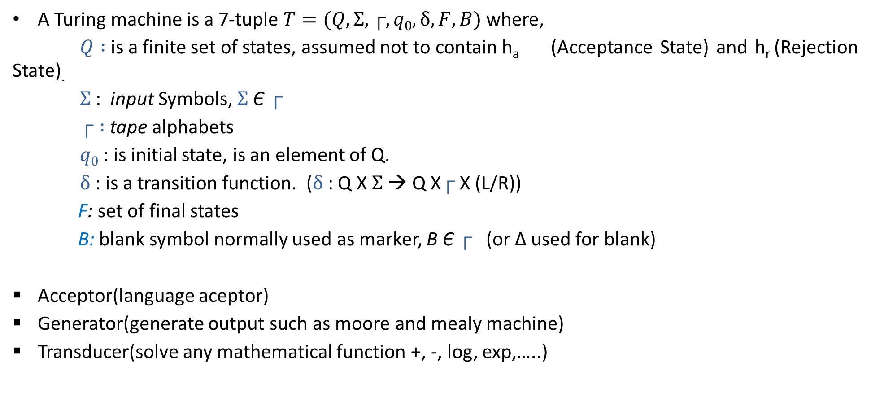
Definition: Turing Machine
A Turing machine is a 7-tuple $T=(Q,Σ,┌,q0,δ, F, B)$ where,
$Q :$is a finite set of states, assumed not to contain h_{a} (Acceptance State) and h_{r} (Rejection State).
$Σ$: input Symbols, $Σ$Є $┌$
$┌ :$ tape alphabets
$q0$ : is initial state, is an element of Q.
$δ$ : is a transition function. ($δ$ : Q X $Σ$ → Q X$┌$ X (L/R))
F: set of final states
B: blank symbol normally used as marker, B Є $┌$ (or ∆ used for blank)
Acceptor(language aceptor)
Generator(generate output such as moore and mealy machine)
Transducer(solve any mathematical function +, -, log, exp,…..)

Slide 8
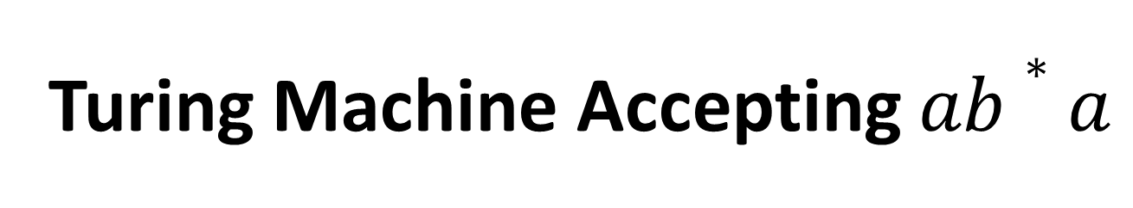
Turing Machine Accepting $ab∗a$

Slide 9
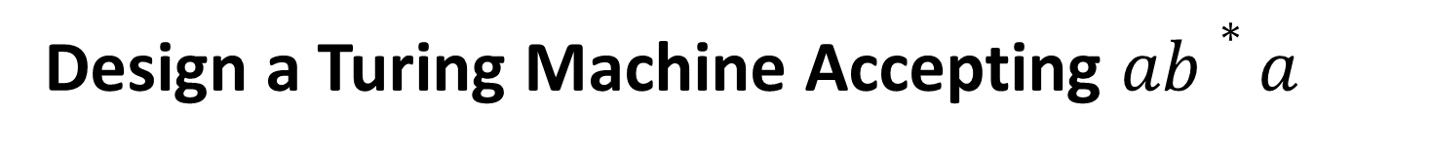
Design a Turing Machine Accepting $ab∗a$
L = {ab*a}
Strings accepting in given L are:
aa
a b a
a b b a
a b b b a
Tape
a
a
Δ
A
b
Δ
B
A
A
b
a
a
B
B
Δ
Δ
b
A
Logic:
Read ‘a’, replace ‘a’ by ‘A’ (a→A)
Read all ‘b’ one by one & replace it by ‘B’ (b→B)
if no ‘b’ found: SKIP step 2
Read ‘a’, replace ‘a’ by ‘A’ (a→A)
A
a
Δ
a
A
Δ

Slide 10



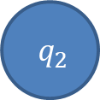
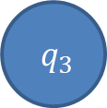
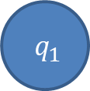
Design a Turing Machine Accepting $ab∗a$
Tape
a
a
Δ
A
b
Δ
B
A
$${ h}_{r}$$
b|B,R
a|A,R
b|B,R
b|B,R
$${ q}_{0}$$
Δ|Δ,R
$${ q}_{1}$$
a|A,R
$${ q}_{2}$$
a|A,R
$${ q}_{3}$$
Δ|Δ,R
$${ h}_{a}$$
Control portion

Slide 11
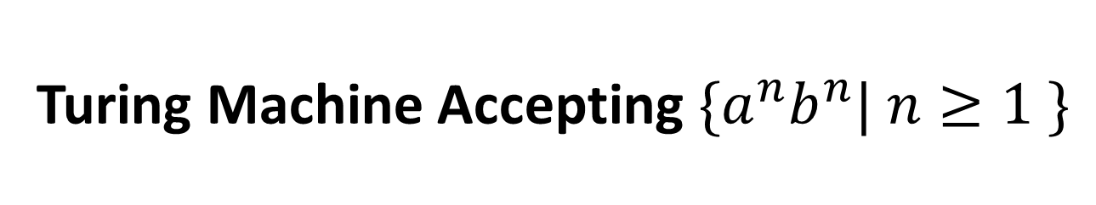
Turing Machine Accepting${ \{a}^{n}b^{n}| n≥1 \}$

Slide 12
Design a Turing Machine Accepting${ \{a}^{n}b^{n}| n≥1 \}$
L = {a^{n}b^{n}}
Strings accepting in given L are:
a b
a a b b
a a a b b b
Tape
a
A
B
A
a
b
B
Δ
b
Δ
Logic:
Read ‘a’, replace ‘a’ by ‘A’ (a→A)
Move RIGHT to first ‘b’
if none : REJECT
Replace ‘b’ by ‘B’ (b→B)
Move LEFT to leftmost ‘a’
Repeat the above steps until no more a’s
Make sure no more b’s remain.
a
a
A
B
A
A
a
b
b
b
Δ
B
B
Δ

Slide 13
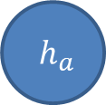

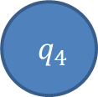
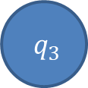

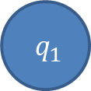
Design a Turing machine for accepting ${\{a}^{n}b^{n}| n≥1 \}$
A
a
A
B
a
b
Δ
B
b
Δ
B/B,R
B/B,L
a/a,R
a/a,L
$${ q}_{0}$$
Δ/Δ,R
$${ q}_{1}$$
a/A,R
$${ q}_{2}$$
b/B,L
$${ q}_{3}$$
B/B,R
A/A,R
$${ q}_{4}$$
B/B,R
Δ/Δ,R
$${ h}_{a}$$

Slide 14
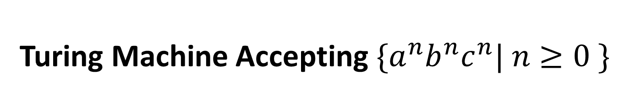
Turing Machine Accepting${ \{a}^{n}b^{n}c^{n}| n≥0 \}$

Slide 15


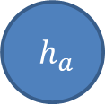
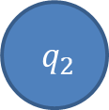
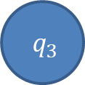



Design a Turing machine for accepting ${\{a}^{n}b^{n}c^{n} | n≥0 \}$
a/a,R
b/b,R
C/C,L
B/B,R
C/C,R
a/a,L
a
a
c
$${ q}_{2}$$
b/B,R
$${ q}_{3}$$
c/C,L
$${ q}_{4}$$
b/b,L
B/B,L
A
b
B
B
c
Δ
A
b
C
C
Δ
a/A,R
A/A,R
$${ q}_{0}$$
Δ/Δ,R
$${ q}_{1}$$
Δ/Δ,R
$${ h}_{a}$$
B/B,R
$${ q}_{5}$$
C/C,R
Δ/Δ,S
$${ q}_{6}$$
B/B,R
C/C,R

Slide 16
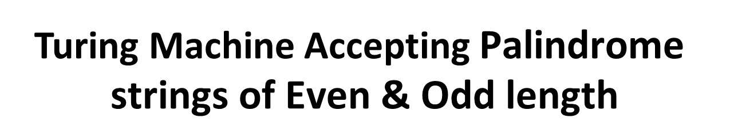
Turing Machine Accepting $\text{Palindrome} \text{strings} \text{of} \text{E}\text{ven}\text{ \& }\text{O}\text{dd} \text{length}$

Slide 17
Design a TM for accepting Palindrome strings of even & odd length.
L = Palindrome string
Strings accepting in given L are:
a a
b a b
a b b a
b a b a b
Tape
Δ
b
Δ
Δ
b
Δ
a
Δ
a
Δ
Even Length
Δ
a
Δ
b
Δ
b
Δ
a
b
Δ
Δ
Δ
Logic:
Read leftmost symbol , replace it with Δ
Keep moving to the right until the rightmost symbol,
If matched with leftmost symbol then replace it with Δ
Otherwise : REJECT the String
Repeat the above steps until no more symbol left in string.
Odd Length

Slide 18

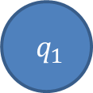


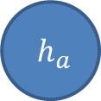

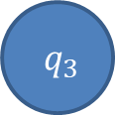

Design a TM for accepting Palindrome strings of even & odd length.
a/a,R
b/b,R
Δ/Δ,R
(odd pal)
Δ
Δ
Δ
Δ
Δ
a
b
b
a
Δ
$${ q}_{2}$$
Δ/Δ,L
$${ q}_{3}$$
a/a,L
b/b,L
a/Δ,R
a/Δ,L
$${ q}_{0}$$
Δ/Δ,R
$${ q}_{1}$$
Δ/Δ,R
$${ q}_{4}$$
$${ h}_{a}$$
b/Δ,R
b/Δ,L
Δ/Δ,L
Δ/Δ,R
$${ q}_{5}$$
$${ q}_{6}$$
(odd pal)
a/a,R
b/b,R
Δ/Δ,R
(even pal)

Slide 19
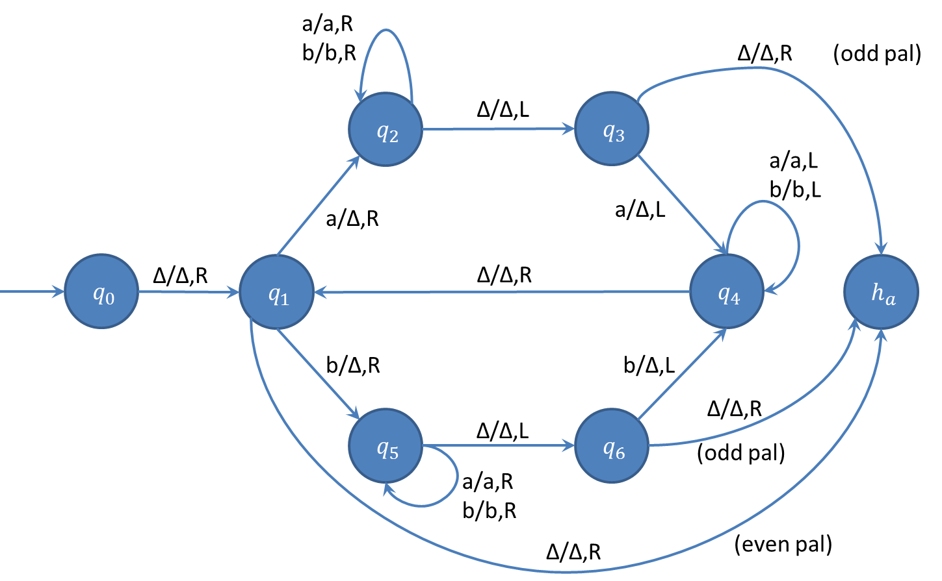
String Tracing
├ (q₀,△ a a)
├ (q₁,△ a a)
├ (q₂,△ △ a )
├ (q₂,△ △ a △ )
├ (q₃,△ △ a )
├ (q₄,△ △ )
├ (q₁,△ △ △)
├ (h_{a}, △ △ △ △)
Accept
Exercise
aba
abab

Slide 20
TM Accepting same no of 0’s and 1’s

Slide 21
Design a TM for accepting same no of 0’s and 1’s
L = Same no. of 0’s and 1’s
Strings accepting in given L are:
01
10
0101
1100
100011
Δ
x
x
1
0
x
x
0
1
Δ
x
0
1
x
x
Δ
x
x
0
1
0
x
1
Δ
Logic:
Move right, Read first leftmost 0, replace 0 with X (0→X)
Keep moving to the left until you encounter Δ
Move right, Read first leftmost 1, replace 1 with X (1→X)
Keep moving to the left until you encounter Δ
Repeat the above steps until no more 0’s and 1’s left in string.

Slide 22






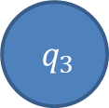
Design a TM for accepting same no of 0’s and 1’s
X
0
0
1
Δ
1
X
X
X
Δ
1/1,R
x/x,L
x/x,R
x/x,L
x/x,R
1/1,L
0/0,R
0/0,L
Δ/Δ,R
$${ q}_{0}$$
$${ q}_{1}$$
0/x,L
$${ q}_{2}$$
Δ/Δ,R
$${ q}_{3}$$
1/x,L
$${ q}_{4}$$
Δ/Δ,L
Δ/Δ,R
$${ q}_{5}$$
Δ/Δ,R
$${ h}_{a}$$
x/x,L

Slide 23
TM Accepting same no of a’s, b’s & c’s

Slide 24



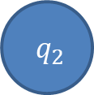





Design a TM for Accepting ${\{x ∊\{a,b,c\}}^{∗}| na\left(x\right)=nb\left(x\right)=nc(x) \}$
a
X
X
X
X
c
b
b
c
a
X
Δ
X
Δ
x/x,R
b/b,R
c/c,R
x/x,L
b/b,L
c/c,L
x/x,R
a/a,R
c/c,R
x/x,L
a/a,L
c/c,L
x/x,R
b/b,R
a/a,R
x/x,L
b/b,L
a/a,L
$${ q}_{0}$$
Δ/Δ,R
$${ q}_{1}$$
a/x,L
$${ q}_{2}$$
Δ/Δ,R
$${ q}_{3}$$
b/x,L
$${ q}_{4}$$
Δ/Δ,R
$${ q}_{5}$$
c/x,L
$${ q}_{6}$$
Δ/Δ,L
Δ/Δ,R
$${ q}_{7}$$
Δ/Δ,S
$${ h}_{a}$$
x/x,L

Slide 25
Turing machine to delete a symbol

Slide 26
Design a Turing machine to delete a symbol
ΔaabΔ
Δ
a
Δ
a
b
Δ
b
Logic:
Replace the symbol you want to delete by Δ.
Keep moving to the Right until you encounter Δ.
One by one Keep shifting every symbol one step to left until you encounter Δ.

Slide 27





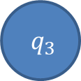
Design a Turing machine to delete a symbol
a/a,L
a
Δ
a
b
a
Δ
Δ
b
b
Δ
$${ q}_{3}$$
a/a,R
b/b,R
a/Δ,R
Δ/Δ,R
a/Δ,L
Δ/a,S
$${ q}_{0}$$
b/Δ,R
$${ q}_{1}$$
Δ/Δ,L
$${ q}_{2}$$
$${ h}_{a}$$
b/a,L
a/b,L
b/Δ,L
Δ/b,S
$${ q}_{4}$$
Δ/Δ,S
b/b,L

Slide 28
Turing machine to copy a string

Slide 29
Design a Turing machine to copy a string
String:
Δ ab
Δ bab
Δ
a
a
b
a
Δ
A
B
Δ
Δ
b
Δ
b
Δ ab
Original
Pasted
Δ bab
a
a
b
a
A
B
a
Δ
b
a
b
Δ
b
A
Δ
Δ
Δ
Δ
Δ
b
b
B
a
Original
Pasted

Slide 30



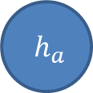

Design a Turing machine to copy a string
a/a,R
a/a,R
b/b,R
b/b,R
a
b
a
b
Δ
Δ
Δ
a
B
Δ
Δ
A
b
$${ q}_{2}$$
Δ/Δ,R
$${ q}_{3}$$
a/a,L
Δ/a,L
a/a,L
b/b,L
b/b,L
a/A,R
$${ q}_{0}$$
Δ/Δ,R
$${ q}_{1}$$
$${ q}_{4}$$
Δ/Δ,L
$${ q}_{5}$$
Δ/Δ,L
b/B,R
Δ/b,L
$${ h}_{a}$$
Δ/Δ,S
$${ q}_{8}$$
$${ q}_{6}$$
Δ/Δ,R
$${ q}_{7}$$
a/a,R
a/a,R
b/b,R
b/b,R
A/a,L
A/A,R
B/b,L
B/B,R

Slide 31










Design a Turing machine for L={WCW|WЄ(a,b)*}
b/b, R
a/a, R
X/X, L
Y/Y, L
X/X, R
Y/Y, R
b/b, L
a/a, L
$${ q}_{0}$$
Δ/Δ,R
$${ q}_{1}$$
a/X,R
$${ q}_{2}$$
C/C,R
$${ q}_{3}$$
a/X,L
$${ q}_{4}$$
C/C,L
$${ q}_{5}$$
X/X, R
b/Y,R
b/b, R
a/a, R
X/X, R
Y/Y, R
X/X, L
Y/Y, L
C/C,R
b/b, L
a/a, L
$${ q}_{6}$$
C/C,R
$${ q}_{7}$$
b/X,L
$${ q}_{8}$$
C/C,L
$${ q}_{9}$$
X/X, R
Y/Y, R
$${ q}_{10}$$
Y/Y, R
$${ q}_{11}$$
Δ/Δ,R

Slide 32
Design a Turing machine for L={WW|WЄ(0,1)*}
The logic for solving this problem can be divided into 2 parts:
Finding the mid point of the string
After we have found the mid point we match the symbols
Lets consider string 1 0 1 1 0 1, so w = 1 0 1 and string is of form (ww).
The first thing that we do is to find the midpoint. For this, we convert 1 in the beginning into Y and move right till the end of the string. Here we convert 1 into Y.
Now move left till, find a X or Y. When we do so, convert the 0 or 1 right of it to X or Y respectively and then do the same on the right end.
Now our string would look like Y X 1 1 X Y. Thereafter, convert these 1’s also and finally it would look like Y X Y Y X Y.
At this point, you have achieved the first objective which was to find the midpoint.

Slide 33
Now convert all X and Y on the left of midpoint into 0 and 1 respectively, so string becomes 1 0 1 Y X Y. Now, convert the 1 into Y and move right till, find Y in the beginning of the right part of the string and convert this Y into a blank (denoted by B). Now string looks like Y 0 1 B X Y.
Similarly, apply this on 0 and X followed by 1 and Y. After this string looks like Y X Y B B B. Now that you have no 0 and 1 and all X and Y on the right part of the string are converted into blanks so our string will be accepted.
Input : 1 1 0 0 1 1 0 0
Output : Accepted
Input : 1 0 1 1 1 0 1
Output : Not accepted

Slide 34
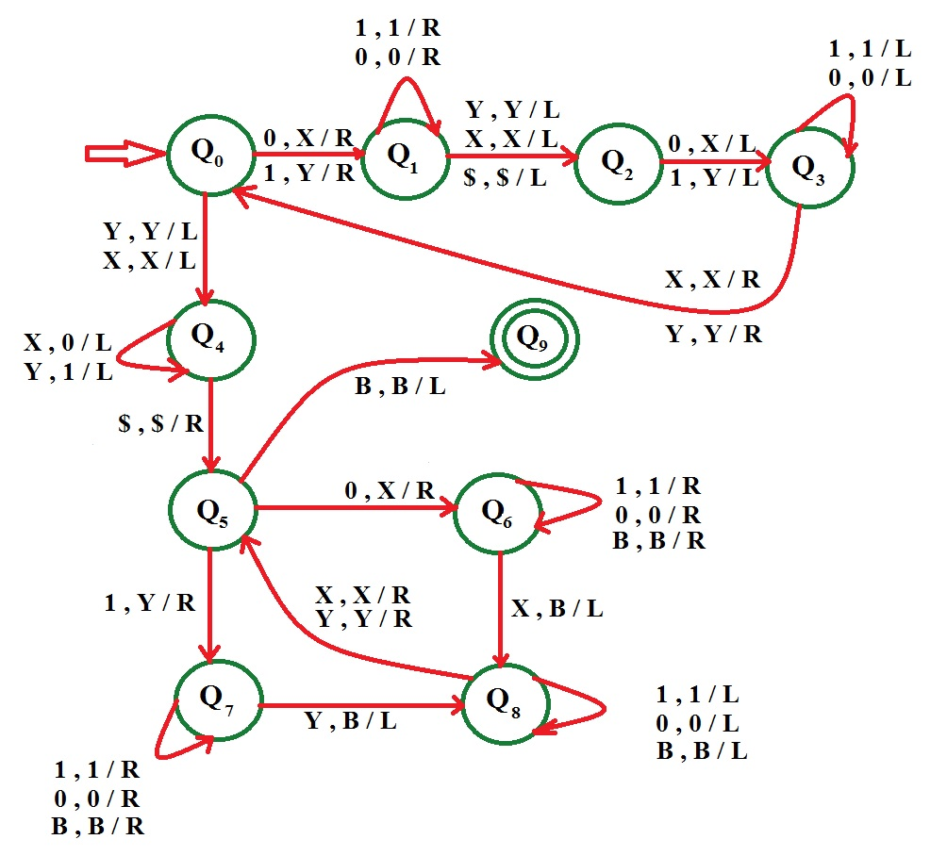

Slide 35
Design a Turing machine for Adder
Approach for Addition
Numbers are given in Unary form
Example: 3 = 111, 2 = 11, 5 = 11111 etc.
For addition of 3 and 4, numbers will be given in TAPE as "B B 1 1 1 0 1 1 1 1 B B".
Convert '0' to '1' and reduce '1' from right
Hence output will be "B B 1 1 1 1 1 1 1 B B B"
Total number of '1' in output is = 7 which is addition of 3 and 4

Slide 36
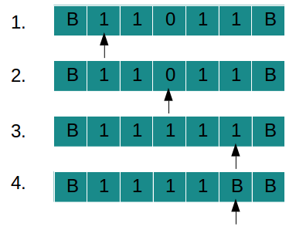
Tap movement
Input is given as "11011" (2 + 2)
Scan string from left to right
Pass all '1'SSS and convert '0' to '1'
Reach BLANK in right
Convert rightmost '1' to BLANK
Addition of 2 and 2 = 4 is written on TAPE Input String : 11011 Output String : 1111

Slide 37
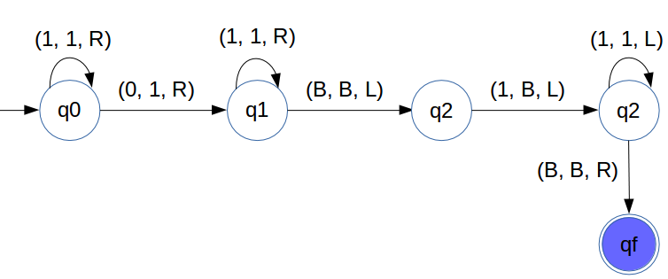

Slide 38
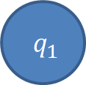

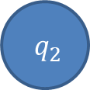
Design a Turing machine from unary to binary
X/X,R
0/0 ,R
X/X,L
1/0,L
Δ Δ Δ Δ Δ Δ C C C C C Δ Δ Δ
$${ q}_{0}$$
C/X,L
$${ q}_{1}$$
Δ/Δ,R
Δ/1,R
0/1,R
$${ q}_{2}$$

Slide 39


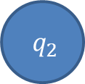

Design a Turing machine for 2’s complement
1/1,R
0/0 ,R
0/0,L
1/0, L
0/1 ,L
$${ q}_{0}$$
Δ/Δ,L
$${ q}_{1}$$
1/1,L
$${ q}_{2}$$
Δ/Δ,R
$${ q}_{3}$$

Slide 40
Problems
Construct Turing machine for L = {a^{n} b^{m} a^{(n+m)} | n,m≥1}
Construct a Turing Machine for language L = {0^{2n}1^{n} | n>=0}
Construct a Turing Machine for language L = {a^{n} b^{m} c^{nm} where n >=0 and m >= 0}

Slide 41
Universal Turing Machine

Slide 42

Universal Turing machine
The language
$$ATM=\left\{<M, w> | M is a Turing machine \& M accepts w\right\}$$
is Turing Recognizable
Possible results:
M accepts w: will halt and accept
M rejects w: will halt and reject
M loops on w: will not halt

Slide 43
Finite Control
TM1 TM2 TM3……………………….
1 0 0 1 0 1
q1 q2 q2 q3……….
Description of TM’s
I/O Tap
Internal states
TM1: (q1,1)→(q2,X,R)
(q2,0)→(q2,X,R)
…….

Slide 44
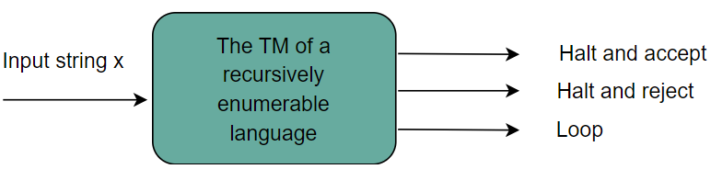
Recursively enumerable languages
Recursively enumerable languages are the universal set of all the languages, and the remaining languages are their subsets.
Recursively enumerable languages are those whose strings the Turing machine (TM) accepts. These strings may do one of the following:
Halt and accept
Halt and reject
Loop forever
Turing machines for recursively enumerable languages may not always halt, and continue to run endlessly for strings that are not a part of that language.
Recursively enumerable languages are also called Turing recognizing languages

Slide 45
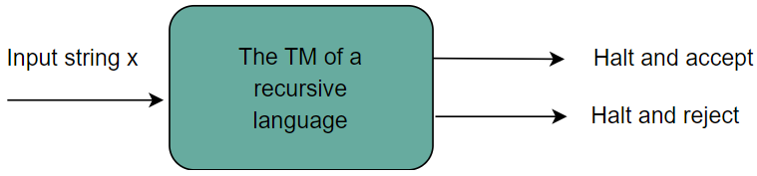
Recursive languages
Recursive languages are those whose strings are accepted by a total Turing machine that does either of the following:
Halt and accept
Halt and reject
Total turing machine: A turing machine that always gives some input, i.e., it does not go into an infinite loop.
A TM of a recursive language never goes into a loop and always halts in every case. Recursive languages are hence also called Turing decidable languages.

Slide 46
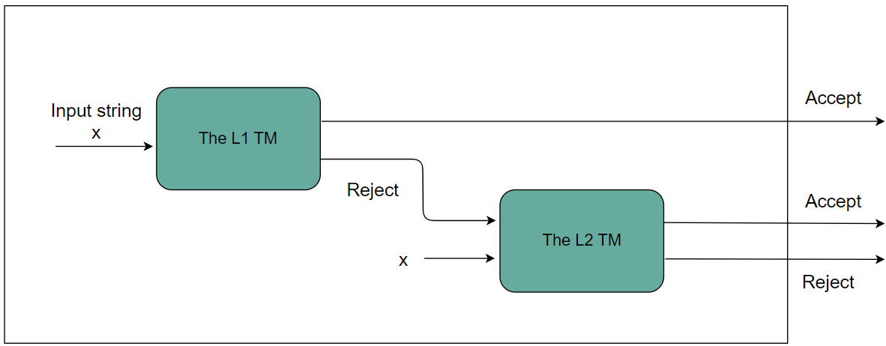
Closure properties of recursive language
Union: The union of two recursive languages L1​ and L2​ is also a recursive language. This is, if the TM accepts any one of the languages, it also accepts L1​∪L2​.

Slide 47

Intersection: The intersection of two recursive languages L1​ and L2​ is also a recursive language. This is, if the TM accepts both languages, it also accepts L1​∩L2​.

Slide 48
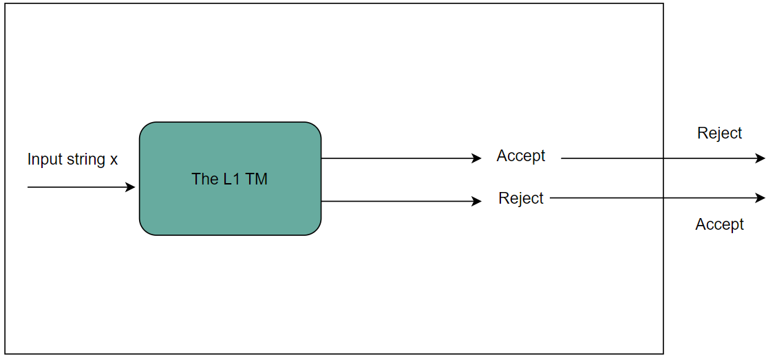
Complement: The complement of a recursive language L1​ is also a recursive language. This is, if the TM accepts L1​, it rejects it as a final output.

Slide 49
Kleene's closure: The Kleene's closure of a recursive language L1​ is also recursive. This is, if L1​={0^{i}1^{j}} is recursive, then L1*​={0^{i}1^{j}}* is also recursive.
Note: All recursively enumerable languages are recursive, but not vice versa.

Slide 50
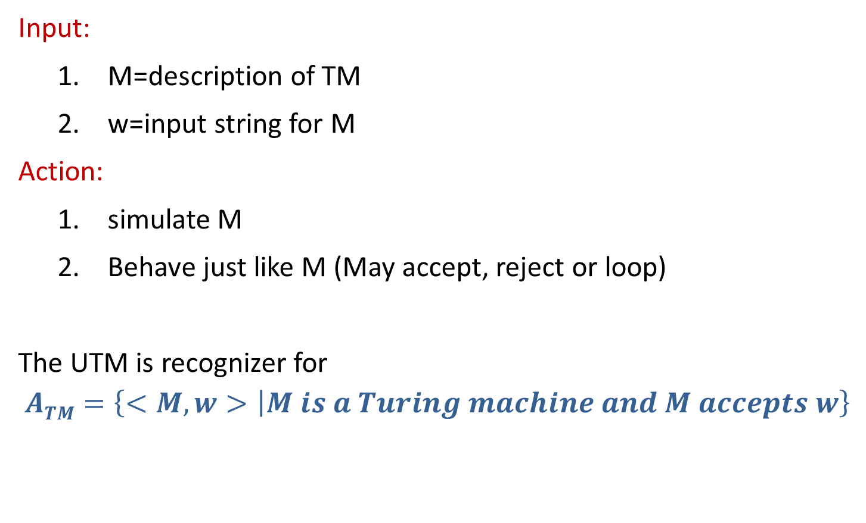
Input & Action on Universal Turing machine
Input:
M=description of TM
w=input string for M
Action:
simulate M
Behave just like M (May accept, reject or loop)
The UTM is recognizer for
$$ATM=\left\{<M, w> | M is a Turing machine and M accepts w\right\}$$

Slide 51
Church Turing Thesis

Slide 52
Church Turing Thesis
What does computable mean?
Meaning of term Computable was given by:
Alonzo church (Lambda calculus)
Allen Turing (Turing Machine)
Any algorithmic procedure that can be carried out at all, by a human computer or a team of humans or an electronic computer, can be carried out by a TM. This statement usually referred to as Church’s thesis, or the Church-Turing thesis.

Slide 53
Church Turing Thesis
Here is an informal summary of some of the evidence.
Humans normally work with a two-dimensional sheet of paper. A TM tape could be organized so as to simulate two dimensions; one likely consequence would be that the TM would require more moves to do what a human could do in one.
Various enhancements of the TM model have been suggested to make the operation more like that of a human computer, or more convenient & efficient. The multitape TM is an example.
Other theoretical models includes abstract machines with two stacks or with a queue.
Since the introduction of the Turing machine, no one has suggested any type of computation that ought to be included in the category of “algorithmic procedure” and cannot be implemented on a TM.

Slide 54

Question 1
Consider the following types of languages: L1: Regular, L2: Context-free, L3: Recursive, L4: Recursively enumerable. Which of the following is/are TRUE?
I. L3’∪L4 is recursively enumerable II. L2’ ∪L3 is recursive III. L1*∩L2 is context-free IV. L1∪L2― is context-free
a. I only
b. I and III only
c. I and IV only
d. I, II and III only

